Slide 1
Identifying Seattle Real Estate Redevelopment Targets
Ross Frischmuth

Slide 2
Problem Statement
Rapid growth leads to rapid redevelopment.
Single family homes are being torn down and replaced with multifamily units.
Nearby construction is lengthy and unpleasant
Noisy
No Parking
Changes the character of the neighborhood
How can we use publicly available data to identify trends and predict if a given neighborhood is likely to experience high levels of redevelopment?

Slide 3
Data Sources
King County Department of Assessments
Property value history, zoning information, unit information, property sales
City of Seattle
Land use permits, building permits
King County GIS Center
Geographic Information System

Slide 4
King County Department of Assessments
Parcel Data
location, zoning, water, sewer, views, noise, waterfront status, historic status, etc.
Value History
Reliable appraised value over the past 20 years
Sporadic data beyond that
Unit Breakdown
Bedrooms, bathrooms, square footage, etc.
Residential Building
Similar to above, but more granular data
Real Property Sales
List of transactions

Slide 5
City of Seattle
Building Permits
New construction
Improvements
Demolition
Land Use Permits

Slide 6
King County GIS Center
Parcels for King County with Address with Property Information
Full property address
Current tax information
Current ownership information
Zoning information
City, township information

Slide 7
Methodology
Initial Plan
Use building permit information to gather information about houses that have been demolished
Link addresses to parcels
Build dataset of all houses that have been demolished in the past ~5 years
Obstacle
The only available parcel information is for current structure
No historical data on the website, and message with County Auditor is unreturned
Redeveloped Lot Example

Slide 8
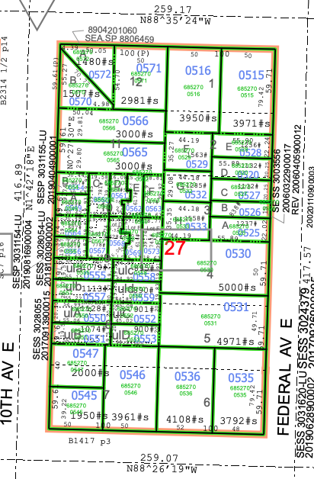

Slide 9
New Potential Methodologies
Only use current projects
Filter out demolish permit applications to ones still pending
Existing structure information still available
n = 1089
Limitations
561,901 total residential parcels in King County
161,521 total residential parcels in Seattle,
Only 0.67% of Seattle residents have pending demolition permits
If predicting will_redevelop label, assign 1 to those pending demolition, but what to do with all of the rest? Need to train with 0s as well.

Slide 10
New Potential Methodologies
Limit analysis to aggregated data
Look at a group of parcels, approximately three city blocks
Look at distribution of construction dates
Compare groups to other similar groups to look for similarities
Limitations
Information loss in aggregated data
Little information gleaned from data – you could just walk around the neighborhood and look for new construction

Slide 11
New Potential Methodologies
Unsupervised learning
Join all tables together on the parcel ID number
Cluster all of the properties based on their features
Assign will_redevelop value of 1 to parcels pending demolition
Check which clusters have high percentage of 1s and predict that these similar ones might experience similar fate.
Limitations
Difficult to assess prediction
This was my plan, but I ran out of time.

Slide 12
Workflow
All data downloaded as CSVs
Pandas proved incapable of handling raw datasets
Struggled with PostgreSQL
Still wouldn’t fix all my problems
Large queries would still crash Pandas, or
Would need to do separate query for every parcel when doing calculations
Settled on importing data into Spark Dataframe
May use EC2 instance depending on how well my local machine manages the full datasets.

Slide 13
Questions?

